Slide 1
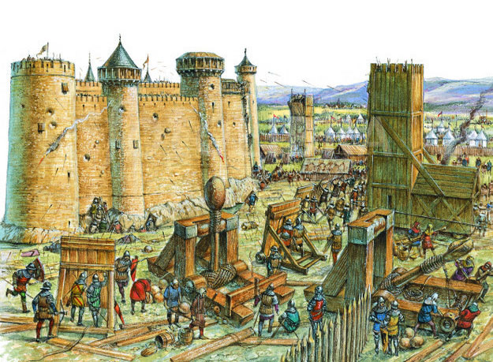
Ye Olde Catapults
Cutting Edge Technology 1500 Years Ago!!!

Slide 2
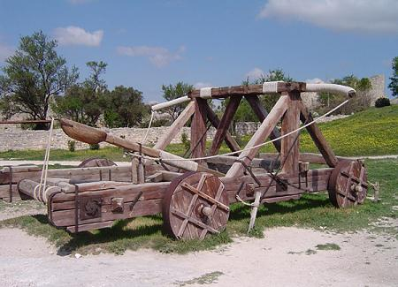
What is a Catapult??
The word “catapult” refers to any machine constructed to throw objects long distances. The way they throw their payloads, and what those payloads are, doesn’t matter. If it throws something a decent distance, it’s a catapult.
4 Types of Traditional Catapults
Ballista
Onager
Mangonel
Trebuchet

Slide 3
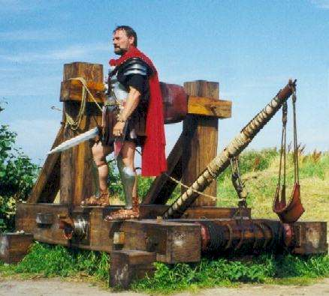
Who Built These? Where?
Ballista = Invented by the Greeks as early as the 4th century BC. The Roman Empire continued the design.
Onager = A Roman design initially, used a sling instead of a spoon.
Mangonel = First designed in the 1100’s for Medieval combat. Used a spoon to hurl large stones.
Trebuchet = The largest siege weapon, invented and used in the Middle Ages. Used a sling and huge weights to throw boulders.

Slide 4
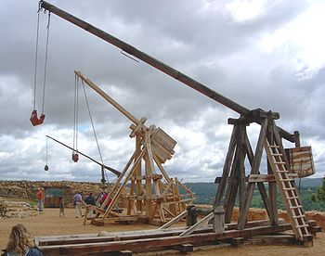
Why were They Built?
The different designs can be attributed to two things: how they were used, and their targets. Some could only throw larger stones or big arrows (bolts) which meant they were used against people. Others hurled huge objects for destroying buildings and fortifications.
Ballista = Fires bolts (large arrows) meant to attack personnel
Onager = Throws medium stones at buildings, walls, or gates.
Mangonel = Hurls stones at either people or small buildings.
Trebuchet = Sends boulders long distances to destroy enemy towns

Slide 5
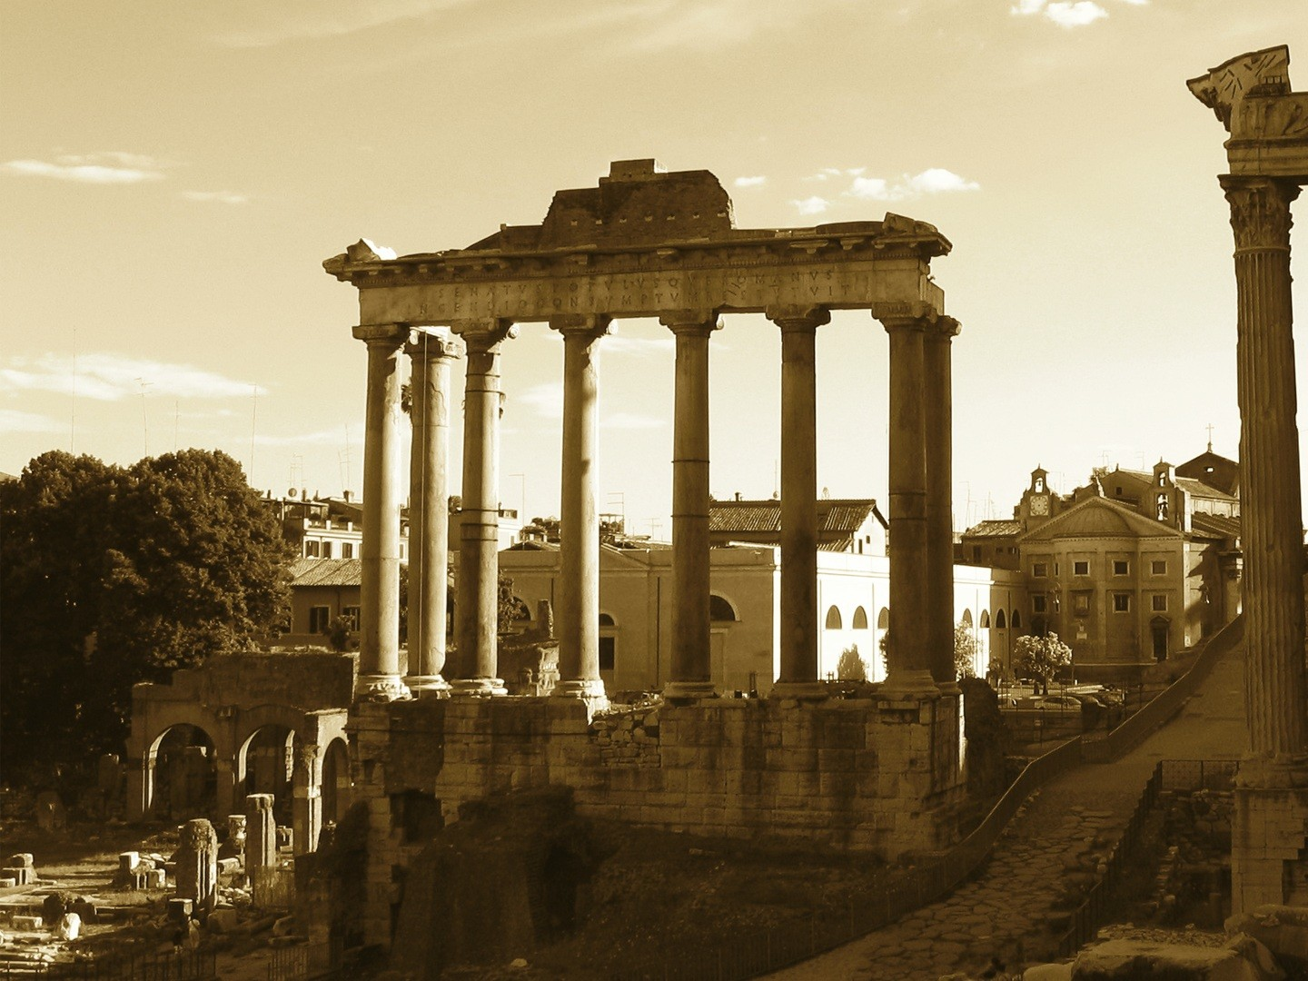
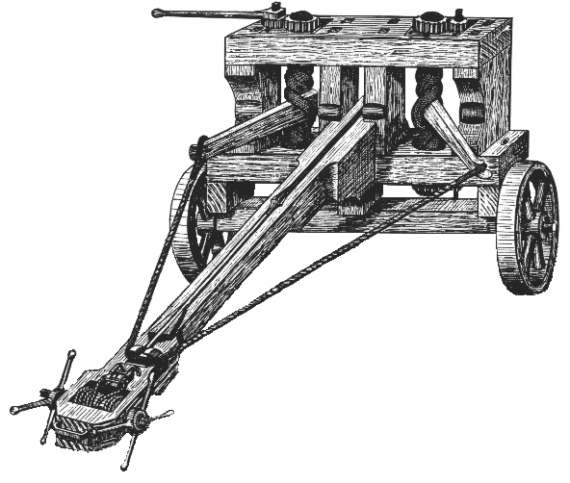
The Ballista
Statistics
Max Range = 500 m
Effective Range = 300 m
Projectile = Bolt
Target = Personnel
Earliest form was seen circa 400 BC, invented for Dionysus the ruler of Syracuse
Fired large arrows or small spears known as bolts
Became most common in the Roman Empire, they even had a chariot mounted one called a carroballista.

Slide 6
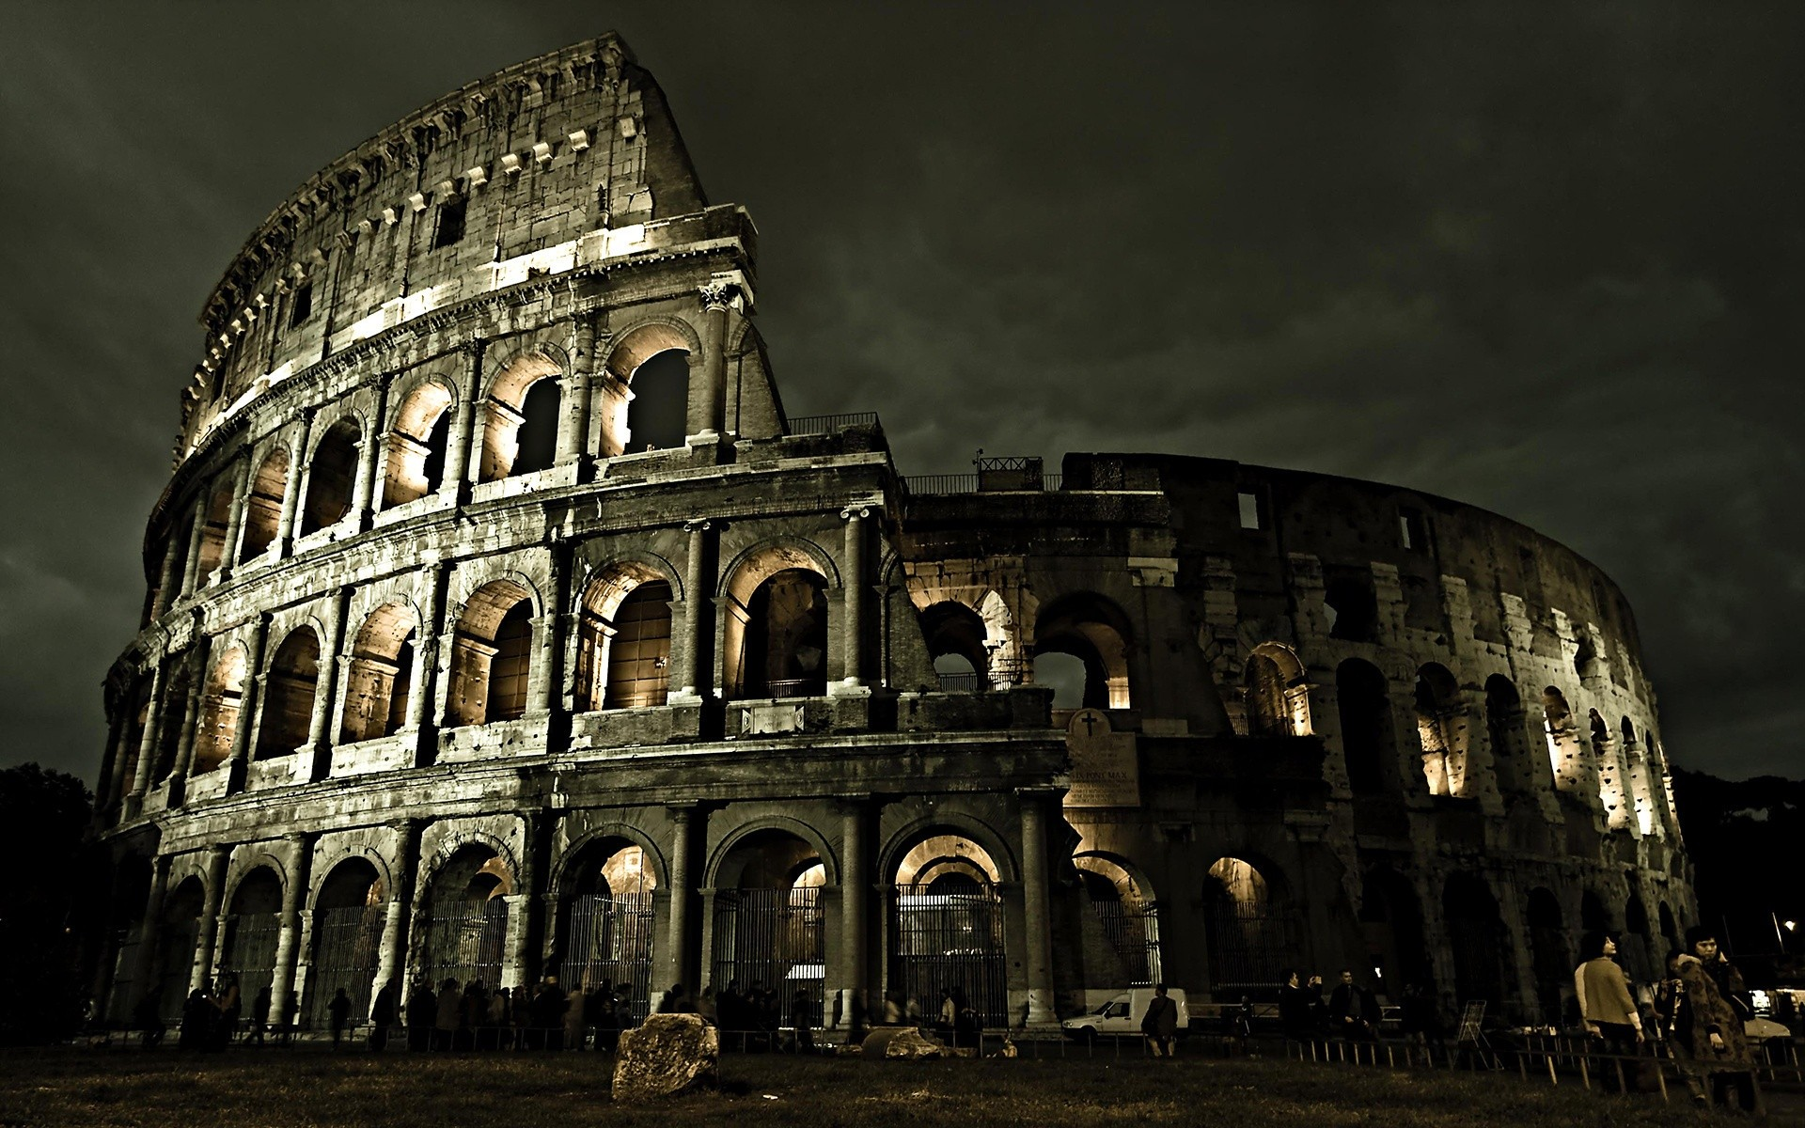
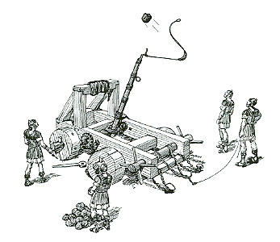
Statistics
Max Range = 300 m
Effective Range = 250 m
Projectile = Stone (70kg)
Target = Fortifications
The Onager
An original Roman design, it used a sling to hurl large stones at buildings or forts
It would have made its debut on the battlefield well after the ballista was in use
The first siege engine designed to destroy buildings
The predecessor to what would be known as the mangonel in the Medieval Period.

Slide 7
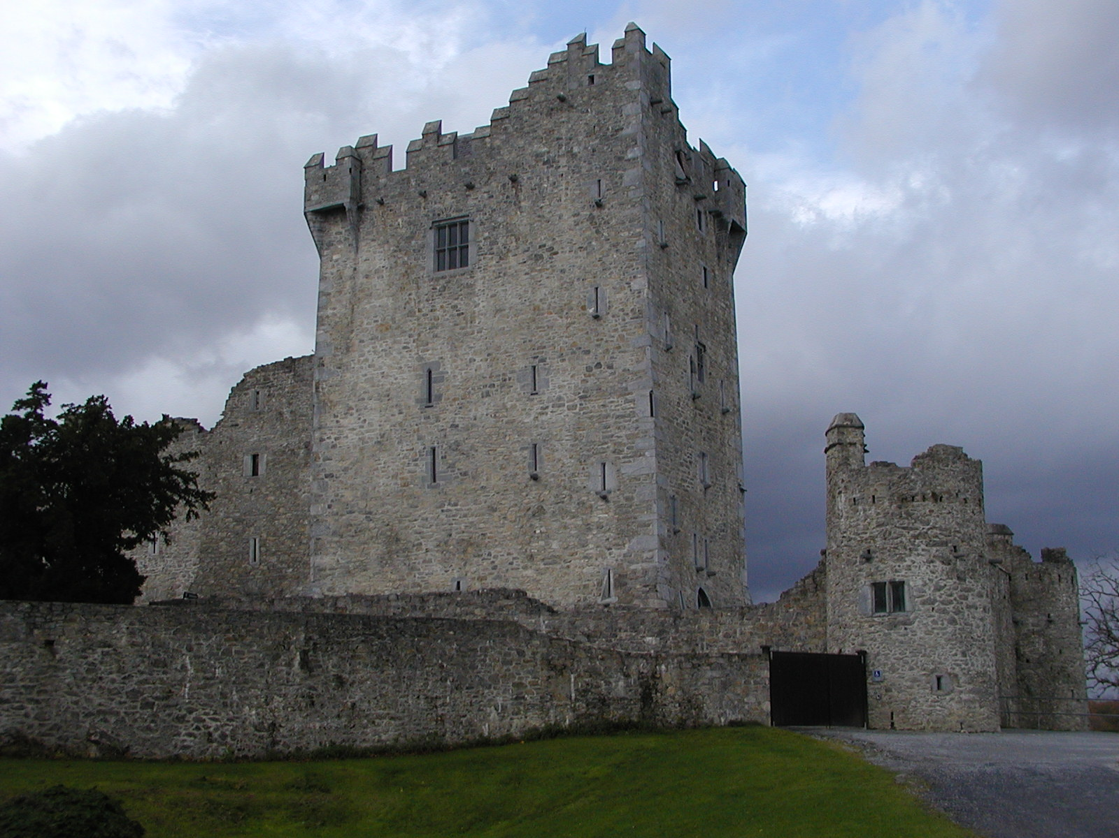
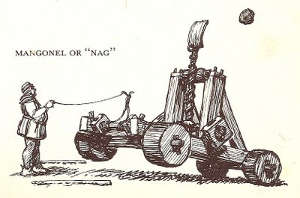
Statistics
Max Range = 400m
Effective Range = 350m
Projectile = Stones, Boulders
Target = Personnel, Buildings
The Mangonel
Was invented in the 12th century, brother to the Onager
Its design used a spoon instead of a sling, could apply different ammunition
The spoon could fire almost anything: spears, stones, a large boulder, fire pots, bodies, heads, etc

Slide 8
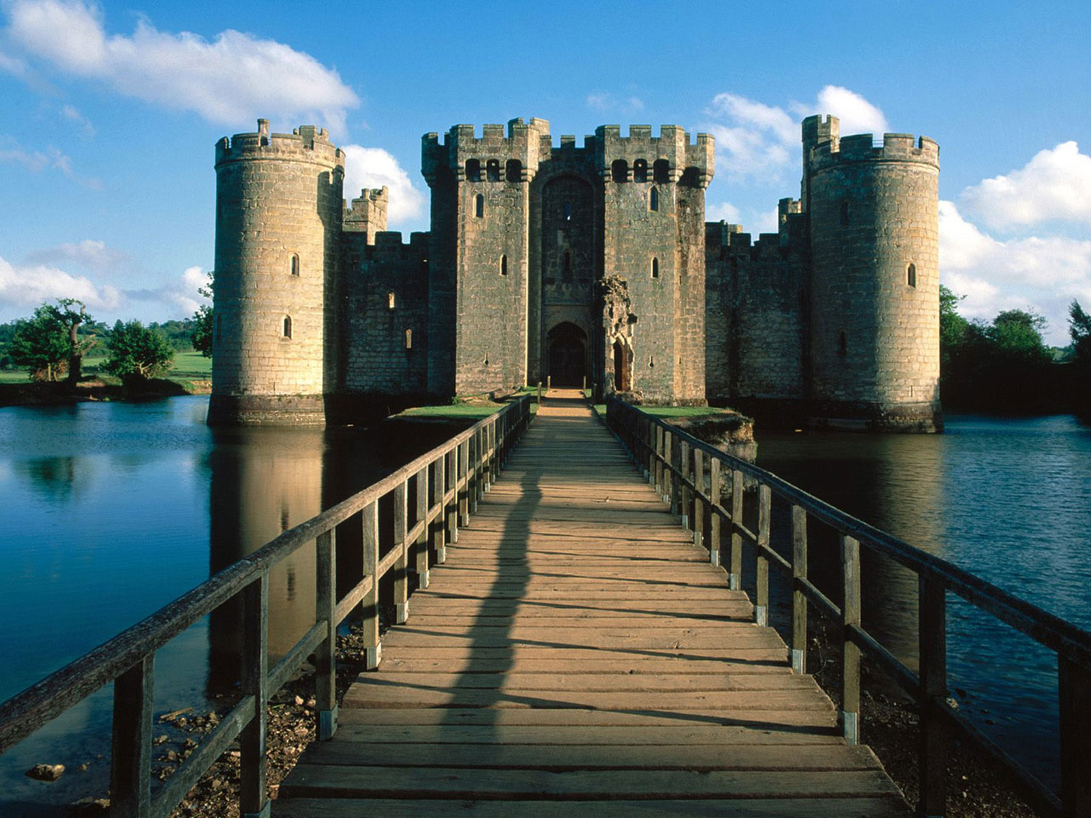
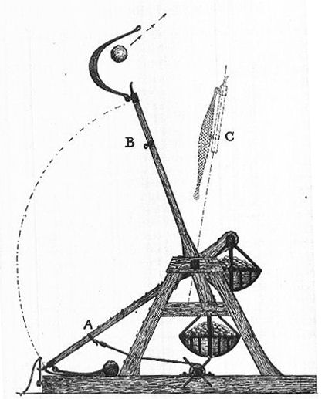
The Trebuchet
Statistics
Max Range = 700+ m
Effective Range = 700m
Projectile = Boulder
Target = Buildings
The trebuchet was the pinnacle of siege warfare during the Medieval Period
It could throw the largest loads the farthest to do the most damage of any other machine
Could be 20 – 30 ft at the rotation with a firing arm just as long
There was so much stress on the machine they had to be built at each siege individually

Slide 9
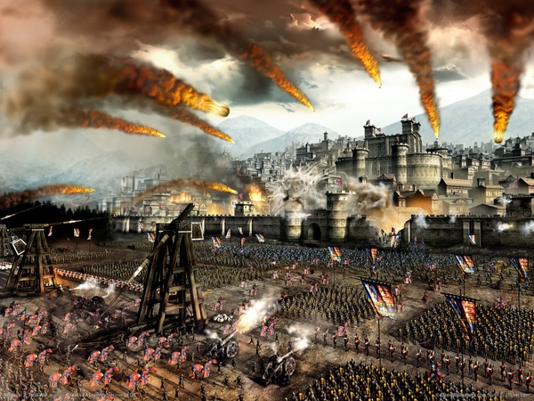
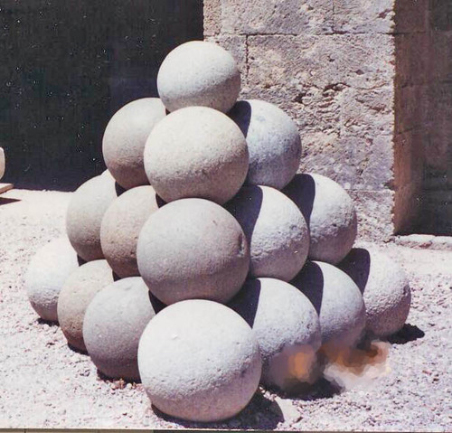
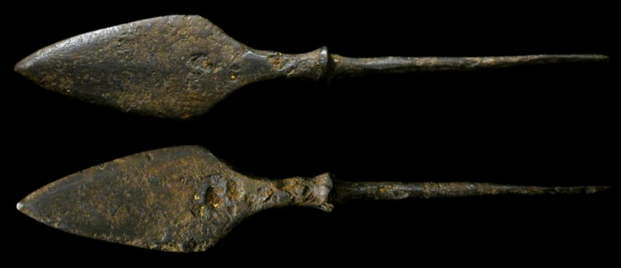
How They Were Used!
Trebuchet = Heavy siege weapon with high projectile trajectory. Used to demolish opponent fortifications or structures (walls, castles, buildings)
Ballista = Anti-personnel or door busting. The bolts it fired were extremely effective against gates/doors (wooden) or enemy combatants

Slide 10
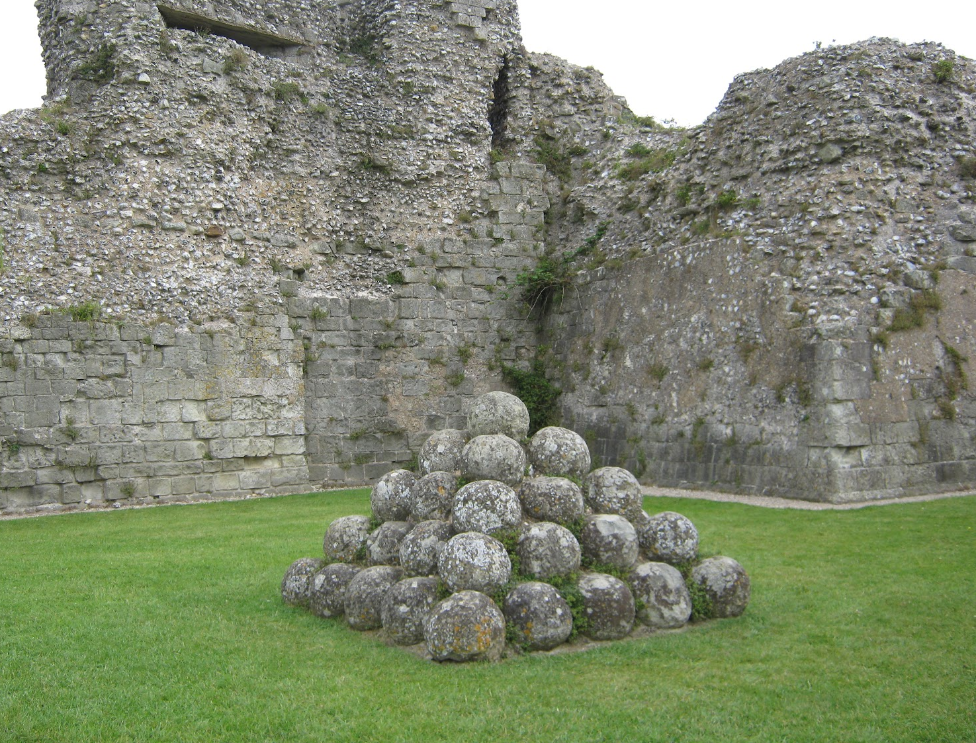
How They Were Used!
Part II
Mangonel = Uses its spoon based delivery system for both siege and anti-personnel. Spoon makes a horizontal trajectory against either structures or people (boulder vs stones)
Onager = Uses a sling delivery system instead of spoon for a vertical projectile trajectory. Uses the height to fire boulders over fortifications past enemy lines

